Slide 1

Sheltered Instruction
WS# 65413
Karina E. Chapa, M.Ed.
Language Proficiency, Biliteracy and Cultural Diversity Director
kchapa@esc1.net
Twitter @esc1bilingual @bilingualpride

Slide 2

Professional Learning Essential Agreements
Be respectful of others
Be an active participant
Take care of your needs
Use electronic devices as learning tools
©2017 Region One Education Service Center

Slide 3
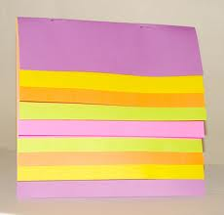
Keeping It Together
Sheltered Instruction

Slide 4
Sheltered instruction
Strategies

Slide 5
Session Objectives
Content Objective
Language Objective
Today I will explore sheltered instruction techniques and strategies to make content comprehensible for my ELLs.
Today I will share different ideas on how to implement sheltered instruction strategies in the classroom.

Slide 6
Three-Step Interview
Stand up when you can complete one of these sentences:
  Teaching ELLs is so difficult because…
  One challenge I face when teaching ELLs is…
  One challenge I face when instructing ELLs is… What I have done to overcome this challenge is…
Beginner
Intermediate
Advanced

Slide 7
What are the two goals of Sheltered Instruction?
Make Content Comprehensible
Develop Academic Language

Slide 8
Content and language objectives

Slide 9

Anticipation Guide
kahoot.it
create.kahoot.it
Let’s Kahoot!

Slide 10
Round Table
Divide a piece of paper in two sections
Create a T chart
Write everything you know about content and language objectives
15 seconds!
Pass your paper to your right!
Repeat!
Content Objectives
Language Objectives
Let’s Write!

Slide 11
The What and the How
Content Objectives come from the TEKS
What am I going to learn?
Language Objectives come from the ELPS
How will I demonstrate my learning through listening, speaking, reading and/or writing?
Content and Language Objectives

Slide 12
Content Objective - Sample
Science TEKS: Differentiate between structure and function in plant and animal cell organelles including cell membrane, cell wall, nucleus, cytoplasm, mitochondria, chloroplast and vacuole.
STUDENT FRIENDLY CONTENT OBJECTIVE
Today I will compare and contrast the cell structures and functions of plants and animals.

Slide 13
Science TEKS: Differentiate between structure and function in plant and animal cell organelles including cell membrane, cell wall, nucleus, cytoplasm, mitochondria, chloroplast and vacuole.
CONTENT OBJECTIVE
Today I will compare and contrast the cell structures and functions of plants and animals.
LANGUAGE OBJECTIVE

Slide 14
Writing Content Objectives
Pair-up
Analyze a Student Expectation (TEKS) from any content area
Write it in a student-friendly format
You have 2 minutes
Write it on the top of a chart paper
Today I will…

Slide 15
Language Objective - Sample
Content Objective:
Today I will compare and contrast the cell structures and functions of plants and animals.
Language Objective:
Today I will write an essay comparing and contrasting plant and animal cells utilizing transitional phrases.

Slide 16
Writing Language Objectives
Pair-up
Look back at the content objective you wrote
Write a language objective in a student-friendly format
You have 2 minutes
Write it on the chart paper below the content objective
Today I will…

Slide 17
Science TEKS: Differentiate between structure and function in plant and animal cell organelles including cell membrane, cell wall, nucleus, cytoplasm, mitochondria, chloroplast and vacuole.
CONTENT OBJECTIVE
Today I will compare and contrast the cell structures and functions of plants and animals.
LANGUAGE OBJECTIVE
Today I will write an essay comparing and contrasting plant and animal cells utilizing transitional phrases.

Slide 18
Key Points to Remember
Make objectives student friendly and appropriate for grade level
Objectives are for students, not for the adults in the classroom
Post eye level
Review with students before, during and after each lesson

Slide 19
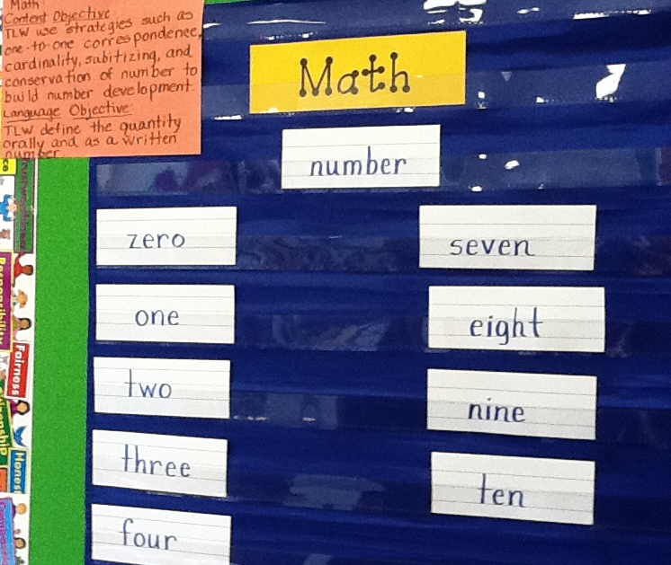
Provide Feedback
Content and Language Objectives

Slide 20
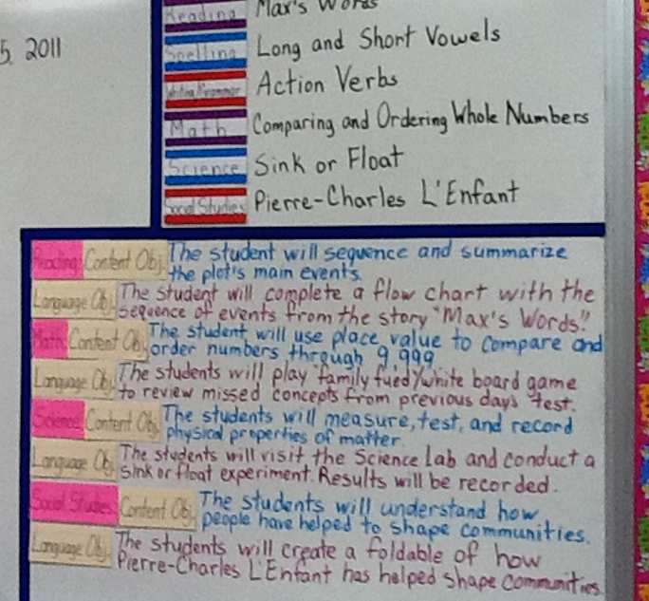
Provide Feedback
Content and Language Objectives

Slide 21
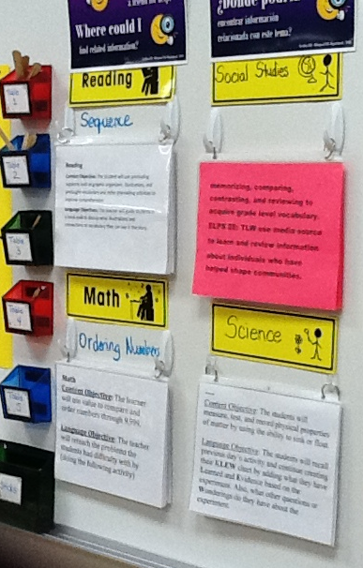
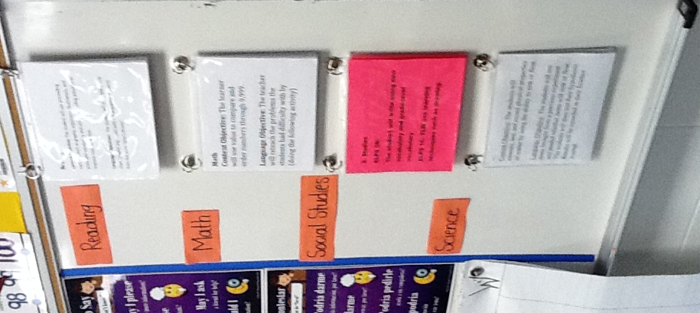
Provide Feedback

Slide 22
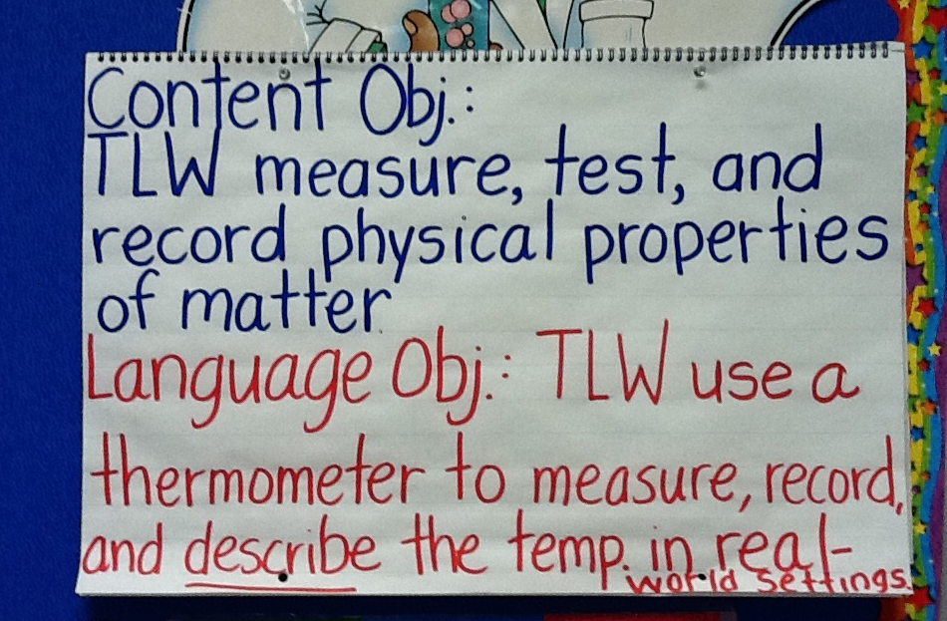
Provide Feedback

Slide 23
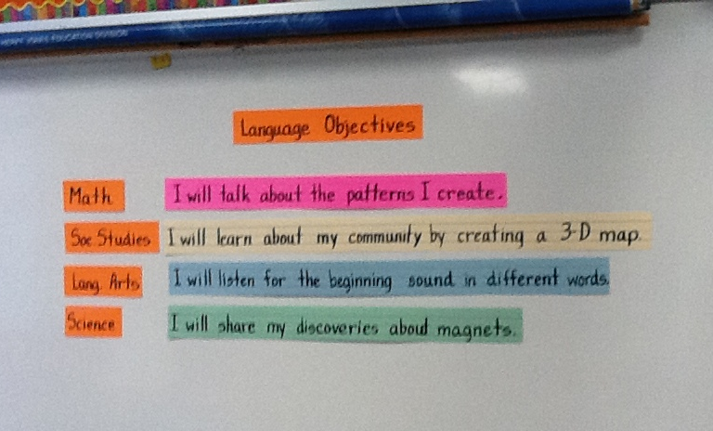
Provide Feedback

Slide 24
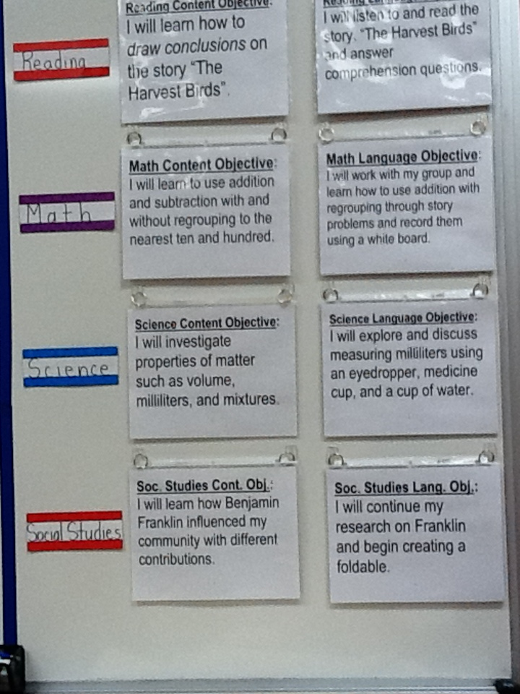
Provide Feedback
Content and Language Objectives

Slide 25
Keeping It Together
Sheltered Instruction
Content and Language Objectives

Slide 26
Speaking in complete sentences

Slide 27
1-2-4-ALL
Why is it important to encourage English Learners to speak in complete sentences?
Write your individual answer on a piece of paper.
Share with a partner and add any new ideas to your paper.
Now share with another pair your answers and keep adding new ideas to your own papers.
As a whole table come up with a final complete answer.

Slide 28
Share Your Answers
iRandomizer App

Slide 29
Use of Complete Sentences
Does this mean that students need to answer in complete sentences all the time?
TIP:
Provide students with sentence frames and sentence starters if they are struggling to produce complete thoughts in English.

Slide 30
Use of Complete Sentences
  1. When reviewing a handout or worksheet
    Non-Example
    Teacher: How much is 5 X 4?
    Student: 20!
    Example
    Teacher: What is the product of 5 X 4?
    Student: The product of 5 and 4 is 20

Slide 31
Use of Complete Sentences
  2. When students are given sentence starters
    Non-Example
    Teacher: Who is your favorite character and why?
    Student: Esperanza!
    Example
    Teacher: Who is your favorite character and why? Please complete the following sentence: “My favorite character is… because…”
    Student: My favorite character is Esperanza, because she was very brave.

Slide 32
Your Turn! Gallery Walk!
Using the Content and Language Objectives that you developed, write 3 questions and 3 sentence stems that your students might be able to answer throughout the lesson.
Write them on post-its and place them on your chart paper.

Slide 33
Keeping It Together
Sheltered Instruction
Content and Language Objectives
Speaking in Complete Sentences

Slide 34
RANDOMIZATION TECHNIQUES

Slide 35
Randomization Techniques
Write-Read-Read-Trade
Stand up when you complete in writing one of these sentences:
  I select who I call on by…
  In my classroom, I include randomization because…
  The most beneficial randomization technique I have used is… because…
  Find your 12 o’clock, share your answers and trade your papers.

Slide 36
Randomization Techniques
Is it possible to randomize and differentiate instruction at the same time?
Randomize and rotate who is called on,
so students of all language levels can participate!

Slide 37
Randomization Techniques
Lucky sticks
Beach ball
Index cards
with student names
Class list/roster
Color/numbers
Birthdays
Physical characteristics: longest hair, eye color…
Jenga
Pick up sticks
Career cards
Apps
Popcorn

Slide 38
Keeping It Together
Sheltered Instruction
Content and Language Objectives
Speaking in Complete Sentences
Randomization Techniques

Slide 39
Total response signals

Slide 40
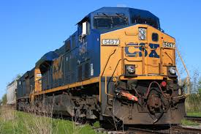
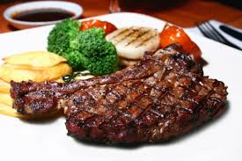
Why is it important to check for understanding along the way?

Slide 41
Written Responses
Hold up paper
White boards
Ready Responses
Hands up when ready
Personal Chalkboards
Answers on cards
Thinker’s chin
Stand up when ready
Put your pen on your paper when ready
All eyes on teacher
Making Choices
Open hand/closed hand
Ranking
Rank with your fingers
Thumbs/Pens up/down
Number wheels
Green card/red card
Move to the corner/spot
Rank with your arm
Line up according to response
Knocking/clapping/
cheering

Slide 42
Find the Fib!
Students may work in pairs or small groups.
Students have three post-its/index cards with the numbers “1, 2, 3” in each card.
Teacher writes 3 statements on the board (one false, two true) and students decide which one is the fib.
On signal from teacher, students show the number of the statement they believe is the fib.

Slide 43
Let’s Play!
Find the Fib
Evaporation is part of the water cycle
Refraction is part of the water cycle
Condensation is part of the water cycle
      I believe number… is a fib because…

Slide 44
Find the Fib
Cognitive and academic development in native language has an important and positive effect on second language acquisition.
Once students can speak English, they are ready to undertake the academic tasks of the mainstream classroom.
According to research, students in ESL-only programs, with no schooling in their native language, take 7-10 years to reach grade level norms.
Let’s Play!

Slide 45
Let’s Play!
Find the Correct Answer
Rhea is a moon of Saturn. Which of these facts about Rhea best indicates that it does not have a water cycle in which water changes state?
A Its radius is 765 km.
B Its density is about 1.3 kg/m3.
C Its period of rotation is about 4.5 Earth days.
D Its temperature is between −174°C and −220°C.

Slide 46
Keeping It Together
Sheltered Instruction
Content and Language Objectives
Speaking in Complete Sentences
Randomization Techniques
Total Response Signals

Slide 47
Developing academic vocabulary

Slide 48
1. When you can complete this sentence in your mind, please stand up.
Academic vocabulary development is important for ALL students, but especially for ELLs, because…
2. Find your 9 o’clock appointment and share your responses.

Slide 49
What does this mean?
Carving is appropriate for most green and blue slopes and even some black slopes. However, if you try to carve through moguls, especially in packed powder or corn snow, you’re going to face-plant.

Slide 50
What does this mean?
Carving is appropriate for most green and blue slopes and even some black slopes. However, if you try to carve through moguls, especially in packed powder or corn snow, you’re going to face-plant.

Slide 51
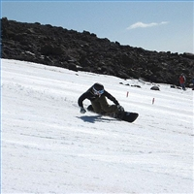

Would this help?
These men are carving.

Slide 52
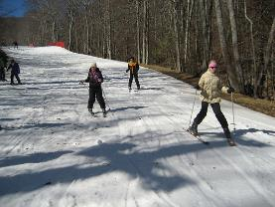
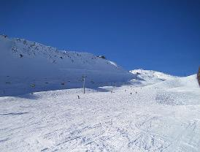
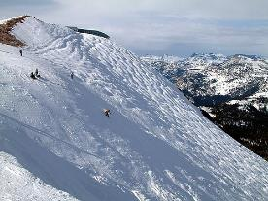
How about this?
Green Slope
Blue Slope
Black Slope

Slide 53
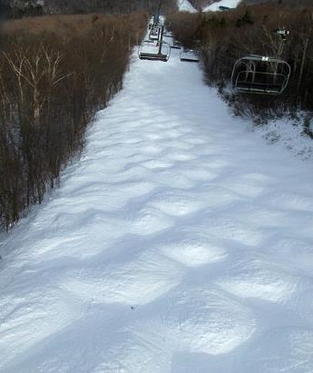
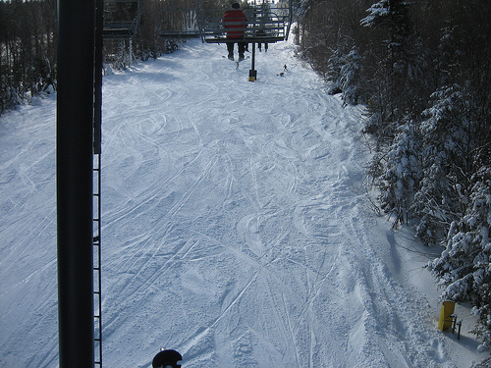
Moguls Packed Powder

Slide 54
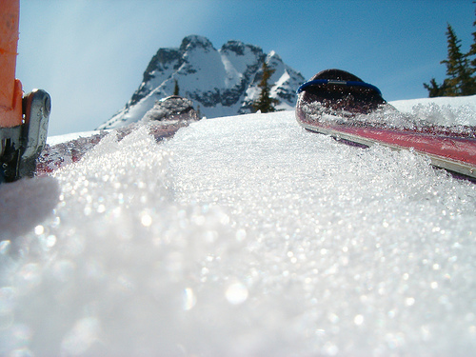
Corn Snow

Slide 55
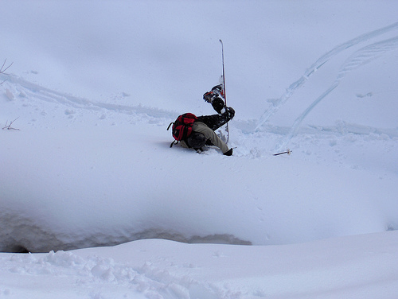
Face-plant

Slide 56
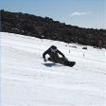








Carving is appropriate for most green and blue slopes
and even some black slopes. However, if you try to carve
through moguls, especially in packed powder or corn snow
you’re going to face-plant.
apropiado
especialmente

Slide 57

The Power of Acceleration: Scenario 1
50 mph
25 mph

Slide 58
The Power of Acceleration: Scenario 1
Gap will widen
50 mph
25 mph

Slide 59
The Power of Acceleration: Scenario 2
50 mph
50 mph

Slide 60
The Power of Acceleration: Scenario 2
Gap will remain the same
50 mph
50 mph

Slide 61
The Power of Acceleration: Scenario 3
50 mph
75 mph

Slide 62
The Power of Acceleration: Scenario 3
Gap will eventually close
50 mph
75 mph

Slide 63
Vocabulary Gallery
Each table researches a different vocabulary strategy
Each team creates a poster explaining the activity
Walk freely through the Vocabulary Gallery!
Gallery Walk

Slide 64




1. Free Association
http://bit.do/freeassociation
2. Comparing Terms
http://bit.do/comparingterms
3. Classifying Terms
4. Solving Analogy Problems
5. Creating Metaphors
6. Vocabulary Charades
7. Talk a Mile a Minute
http://bit.do/morevocabulary
8. Pyramid Game
http://bit.do/ pyramidgame
Notes:
3.5 hours

Slide 65
Keeping It Together
Sheltered Instruction
Content and Language Objectives
Speaking in Complete Sentences
Randomization Techniques
Total Response Signals
Developing Academic Vocabulary

Slide 66
Structured reading and writing activities

Slide 67
Structured Language Activities
Adapted Texts
SQP2RS
Graphic Organizers
Thinking Maps
Jigsaw Reading
Outlines
Highlighted Texts
1-2-4-All
Round Table
Taped Texts
Marginal Notes
Native Language Texts
Write-Read-Read-Trade

Slide 68
SQP2RS
Survey: Preview text
Question: 1-3 questions
Predict: 1-3 predictions
Read: Read text
Respond: Answer, modify, drop, add questions
Summarize: Retell the main points of the text

Slide 69
SQP2RS
Survey
Question
Predict
Read
Response
Summarize

Slide 70

Read-Cover-Remember-Retell
SKETCH!

Slide 71
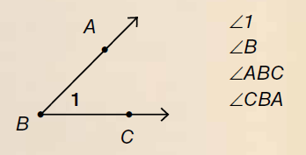
Angles
There are three ways to identify angles: by number, by the vertex, or by three points. If we use three points, they must consist of a point on one ray, the vertex, and a point on the other ray. If you use three points to name an angle, the vertex must be the second point in the name (∠ABC).
There are three ways to name angles. We can name them by number. We can name them by the vertex. We can name them with three points. One point is on one ray. One point is on the vertex. One point is on the other ray. The vertex must be the second point in the name (∠ABC).

Slide 72

Double Entry Journal
Quote
Personal Reflection
“Becky’s father took her to a hardware store, where they bought a special paint that glows after it has been exposed to light for a short time.”
Becky Shroeder, Young Inventor
Paragraph 5
My dad was a chemical engineer, so when I was little he would always encourage me to discover and explore the world around me. One time, he helped me collect rose petals. Then, we put them in a little container with alcohol. The next day, I had a brand new perfume!

Slide 73

Use of Social Media
Twitter for Professional Development
  @esc1bilingual
  @bilingualpride
  @rgv_tabe
  @edutopia
  @ColorinColorado
  @educationweek
  @teainfo

Slide 74
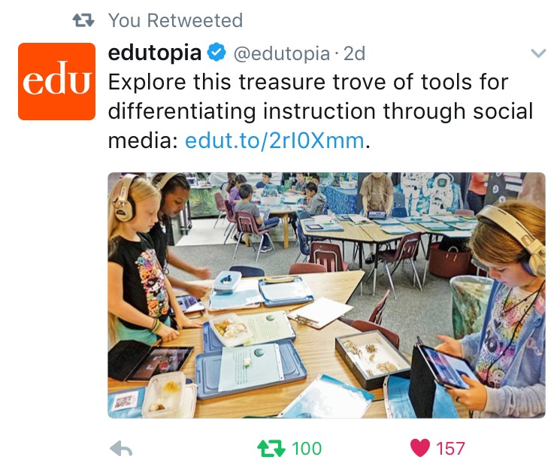
Differentiated Instruction

Slide 75
Thinker’s Chin
One of the benefits of including structured reading and writing activities in my classroom is…
One of the challenges of including structured reading and writing activities in my class is…
Something I can do to overcome this challenge is…

Slide 76
Keeping It Together
Sheltered Instruction
Content and Language Objectives
Speaking in Complete Sentences
Randomization Techniques
Total Response Signals
Developing Academic Vocabulary
Structured Reading and Writing

Slide 77
Structured conversations

Slide 78

Structured Conversations
Think-Pair-Share
Think-Write-Pair-Share
Question-Signal-Stem-Share-Assess
Expert Gallery Walk
Three-Step Interview
1-2-4-All

Slide 79
Keeping It Together
Sheltered Instruction
Content and Language Objectives
Speaking in Complete Sentences
Randomization Techniques
Total Response Signals
Developing Academic Vocabulary
Structured Reading and Writing
Structured Conversations

Slide 80
Session Objectives
Content Objective
Language Objective
Today I explored sheltered instruction techniques and strategies to make content comprehensible for my ELLs.
Today I shared different ideas on how to implement sheltered instruction strategies in my classroom.

Slide 81
Kahoot and twitter
Plus Online Resources

Slide 82
Tickets Out
I used to think…
But now I know…

Slide 83
Thank you for your participation!
See you tomorrow!
Karina E. Chapa, M.Ed.
Language Proficiency, Biliteracy and Cultural Diversity Director
kchapa@esc1.net
Facebook: Region One ESC Bilingual
Twitter @esc1bilingual @bilingualpride

